Slide 1
AWS- CloudFormation
Session 1: Fundamentals of CloudFormation
Date: 6th April 2017

Slide 2
CloudFormation– Introduction
Provision AWS resources via Code (JSON or YAML).
Create, Manage and Delete related AWS resources together as a unit called a Stack.
Templates are JSON files or YAML file which define your stack.
Version Control and Track changes

Slide 3
Template Elements:
AWSTemplateFormatVersion
Description
Metadata
Parameters
Mapping
Conditions
Transform
Resources – Required Section
Outputs
Intrinsic Functions

Slide 4
Template Elements:
AWSTemplateFormatVersion
AWS CloudFormation template version that the template conforms to.
Description
Description about the template.
Metadata
Additional Information about the template

Slide 5
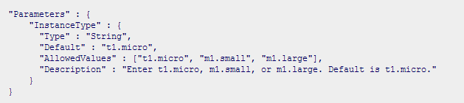
Template Elements Contd.
4. Parameters:
AWS Cloud Formation parameters are values that you define in the template Parameters section.
A parameter can have a default value.
A parameter can be declared as one of following types: String, Number, or CommaDelimitedList.

Slide 6
Template Elements Contd.
AWS-Specific Parameter Types
AWS::EC2::AvailabilityZone::Name
AWS::EC2::Image::Id
AWS::EC2::KeyPair::KeyName
AWS::EC2::SecurityGroup::GroupName
AWS::EC2::SecurityGroup::Id
AWS::EC2::Subnet::Id
AWS::EC2::Volume::Id
AWS::EC2::VPC::Id
AWS::Route53::HostedZone::Id
List <Above Parameters>

Slide 7
Template Elements Contd.
Pseudo Parameters
AWS Cloud Formation Pseudo Parameters are predeclared values you can use in your template.
You do not declare them in your template. Use them the same way as you would a parameter, as the argument for the Ref function.
AWS::AccountId
AWS::Region
AWS::StackId
AWS::StackName
AWS::NotificationARNs
AWS::NoValue

Slide 8
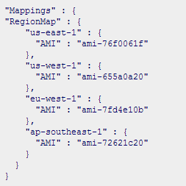
Template Elements Contd.
5. Mappings
Mappings enable you to specify conditional parameter values in your template.
Each mapping has a logical name unique within the template, and defines one or more key-attribute pairs.

Slide 9

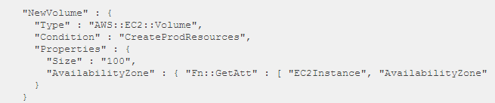
Template Elements Contd.
6. Conditions
Statements that define when a resource is created or when a property is defined.
You might use conditions when you want to reuse a template that can create resources in different contexts, such as a Dev environment versus a production environment.
This is one of the parameter in the Parameters section

Slide 10
Template Elements Contd.
7. Transform
For Lambda-based applications to be provisioned using cloud formation template we use Transform.

Slide 11
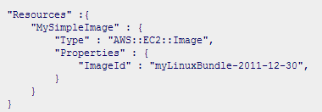
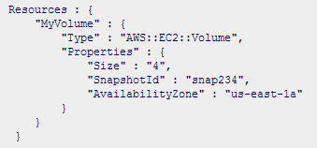
Template Elements Contd.
8. Resources
AWS Cloud Formation Resources are features of AWS products which you declare as members of your stack.
AWS Cloud Formation resource properties are values needed to create a resource.
Every template must declare a Resources section with at least one resource.

Slide 12

Template Elements Contd.
9. Outputs
The Outputs section is an optional section of a AWS Cloud Formation template which enables you to return values back to the template user.
When the stack fails to create, or when you delete a stack, the values declared in the Output section are not returned.

Slide 13

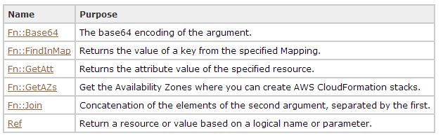
Template Elements Contd.
10. Intrinsic Functions
AWS Cloud Formation provides functions that you can use to pass values that are not available until runtime.

Slide 14
Resource Attribute Reference
CreationPolicy Attribute
Associate the CreationPolicy attribute with a resource to prevent its status from reaching create complete until AWS CloudFormation receives a specified number of success signals or the timeout period is exceeded.
Supported Resources:
AWS::AutoScaling::AutoScalingGroup, AWS::EC2::Instance, and AWS::CloudFormation::WaitCondition.

Slide 15
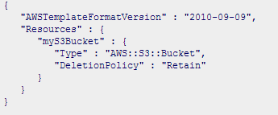
Resource Attribute Reference Contd.
2. DeletePolicy Attribute
Defines how AWS Cloud Formation handles the resource when its stack is deleted.
Values : Delete, Retain, Snapshot

Slide 16
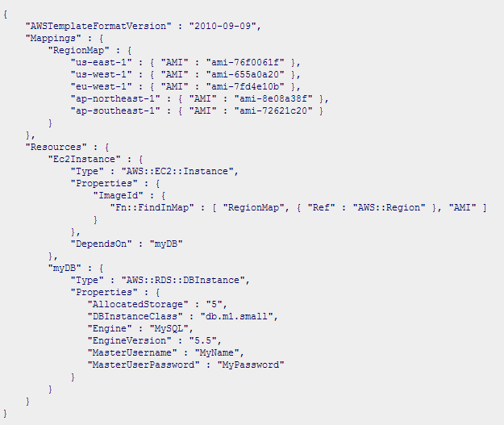
Resource Attribute Reference Contd.
3. DependsOn Attribute
When you add a DependsOn attribute to a resource, you specify that that resource is created only after the creation of the resource specified in the DependsOn attribute.

Slide 17
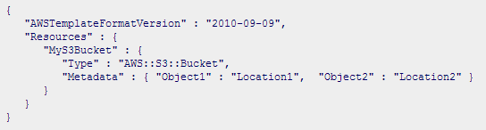
Resource Attribute Reference Contd.
4. Metadata Attribute
By adding a Metadata attribute to a resource, you can add data in JSON format to the resource declaration.

Slide 18
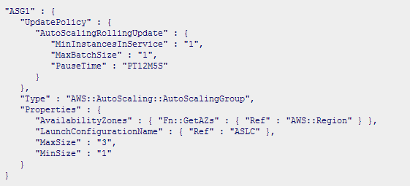
Resource Attribute Reference Contd.
5. Update Attribute
The UpdatePolicy attribute enables you to specify how AWS Cloud Formation handles updates for a particular resource.
Supported Resources:
AWS::AutoScaling::AutoScalingGroup

Slide 19
Best Practices
Use pseudo parameters to retrieve global data
Use Mappings to define variables so that they can be reusable with in the template after defining them once.
Do not use access credentials
Use AWS specific parameters
Validate templates before we use them.
Use of ‘change sets’ would ensure the complex stacks before we update them.
Use nested stacks to reduce the complexity and improve the maintainability by reusing the common Template patterns.

Slide 20
Limitations
AWS CloudFormation has a resource hard limit as 200
AWS CloudFormation ‘does not’ Validate Templete to validate the properties of resources defined in the template.

Slide 21


Demo
1. Creating a CloudFormation for a VPC, one public Subnet. Launch one EC instance in Public Subnet.
Region: ap-southeast-1t
EC2 Server –
Bastion
Internet
Gateway
Public Subnet

Slide 22
Steps:
Create VPC (Say 10.0.0.0/16).
Create IGW and associate with VPC.
Create Public Route table
Create Route table entries for Public RTB with IGW – 0.0.0.0/0.
Create Public Subnet (Say 10.0.1.0/24).
Associate Public Route table with Public Subnet.
Now Network will be ready.
7. Create one EC2 in Public Subnet.

Slide 23

Assignment
1. Creating a CloudFormation for a VPC, one public Subnet and one private Subnet. Launch one EC instance in Public Subnet and one EC2 instance in Private Subnet.
Region: US East
EC2 Server –
Bastion
EC2 Server
Internet
Gateway
Public Subnet
Private Subnet

Slide 24
Steps for Assignment:
Create VPC (Say 10.0.0.0/16).
Create IGW and associate with VPC.
Create Two Route tables – One for Public and one for Private.
Create Route table entries for Public RTB with IGW – 0.0.0.0/0.
Create Public Subnet (Say 10.0.1.0/24).
Associate Public Route table with Public Subnet.
Create NAT Gateway in the Public Subnet created in Step 5.
Create Route table entry for the Private Route table with NAT GW(created in Step 6) for 0.0.0.0/0.
Create Private Subnet (Say 10.0.2.0/24).
Associate Private Route table with Private Subnet.
Now Network will be ready.
11. Create one EC2 in public Subnet.
12. Create one EC2 in private Subnet.

Slide 25
Next Session Topics
Session 2:
Bootstrapping in Cloudformation
UserData, Metadata, cfn-helper scripts
Wait Conditions and Wait Handlers
Nested Stacks
UserData, Metadata, cfn-helper scripts
Wait Conditions

Slide 26
Thank You

